Slide 1
NAME:GOKULA KRISHNAJI.SJ
REGNO.NO:au813821205014
DEPARTMENT:INFORMATION TECHNOLOGY
COLLEGE NAME:SARANATHAN COLLEGE OF ENGINEERING
N.M ID: sjgokulakrishnaji@gmailcom
Final Project

Slide 2
FACIAL IMAGE GENERATION WITH STYLE GAN

Slide 3


AGENDA
PROBLEM STATEMENT
PROJECT OVERVIEW
WHO ARE THE END USERS
OUR SOLUTION AND ITS VALUE PROPOSITION
STANDOUT FEATURES INOUR SOLUTION
MODELING
RESULTS
3/21/2024 Annual Review

Slide 4

PROBLEM STATEMENT
The task of generating realistic facial images has always been a challenge in the field of computer vision. Traditional methods often result in blurry or distorted images that lack fine details and naturalness. This limits their usefulness in applications such as virtual reality, gaming, and character design. The goal of this project is to develop a facial image generation model that can produce high-quality, diverse, and realistic images.

Slide 5

PROJECT OVERVIEW
Methodology
The project utilizes Style GAN, a state-of-the-art generative adversarial network, to generate realistic facial images. Style GAN combines a generator network and a discriminator network to learn the underlying distribution of facial features and generate new images that resemble real human faces.
Approach
The approach involves training the Style GAN model on a large dataset of labeled facial images. The model learns to generate new faces by capturing the style and structure of the training data. The generated images can be used for various applications, such as virtual character creation, data augmentation, and facial recognition research.

Slide 6

WHO ARE THE END USERS?
Professional Artists
Game Developers
Graphic Designers
Researchers
Content Creators
Hobbyists

Slide 7

SOLUTION AND ITS VALUE PROPOSITION
Solution and Value Proposition:
Our proposed solution leverages advancements in deep learning, particularly Style Generative Adversarial Networks (Style GAN), to tackle the challenges associated with facial image generation. We present a comprehensive approach that integrates innovative techniques to enhance realism, diversity, controllability, data efficiency, and ethical representation in generated facial images.
Realism and Diversity Enchancement
Fine-Grained Control Mechanisms
Data Efficiency and Generalization Techniques
Ethical Representation and Bias Representation

Slide 8
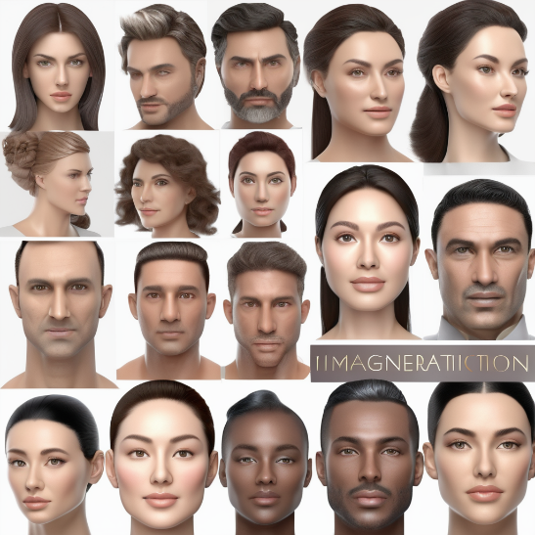

STANDOUT FEATURES OF THIS SOLUTION
Impressive Realism and Variety: This refers to the remarkable quality and diverse range of facial images generated, capturing fine details and variations akin to real human faces.
Unprecedented Customization Capability: The solution provides an unparalleled level of control over facial attributes, enabling users to finely adjust characteristics like age, gender, ethnicity, and expressions with ease.
Efficient Utilization of Limited Data: By achieving remarkable performance with minimal training data, the solution showcases its efficiency and adaptability, making it applicable in real-world settings with data constraints.
Ethical Sensitivity and Fairness Integration: This highlights the solution's commitment to addressing biases and ensuring fair representation, underscoring its ethical considerations and social responsibility in technology development.
8

Slide 9
MODELLING
The facial image generation project utilizes advanced modeling techniques and algorithms to generate realistic and high-quality images. The main technique used in this project is Style GAN (Generative Adversarial Network), which is a deep learning-based model for generating synthetic images. Style GAN is known for its ability to generate highly realistic and diverse images by learning the underlying style and structure of the training data. The model consists of a generator network that generates images and a discriminator network that distinguishes between real and generated images. Through an adversarial training process, the generator learns to produce images that are indistinguishable from real images, while the discriminator learns to accurately classify between real and generated images. This iterative process leads to the generation of high-quality facial images that exhibit realistic features and variations.
9

Slide 10
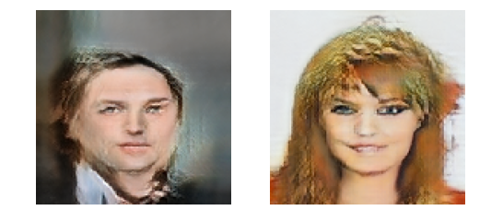
RESULTS
https://github.com/sjgokulakrishnaji/TNSDC-Generative-AI
10

